Slide 1
CS 455 Project
Search vs Genetics
David Jefts and Shawn Mcdonnell

Slide 2
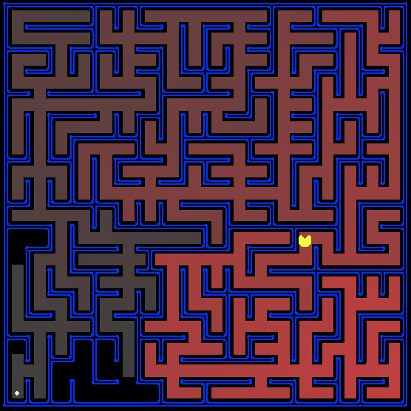
Pacman Maze Solver
Generate random maze levels
Use search algorithms to solve the maze
Use a genetic algorithm to solve the maze
Compare the two in terms of operations, time, and efficiency

Slide 3
Greedy-Best First Search
Pros
Fast results
Scales well
Cons
No guarantee on best path
Poor implementation can lead to infinite branching

Slide 4
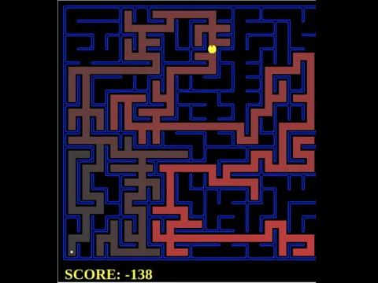
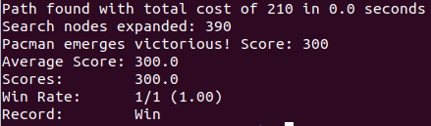
Greedy-Best First Demo

Slide 5
A* Search
Pros
Guarantees shortest path
Cons
Time consuming
Does not scale well

Slide 6
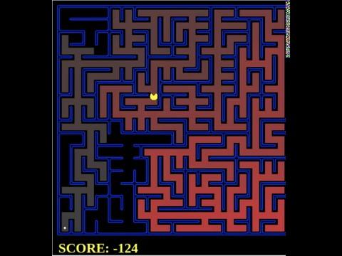
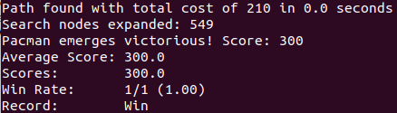
A* Demo

Slide 7
Genetic Algorithm
Pros
Scales extremely well
Cons
Time consuming
Very difficult to implement

Slide 8
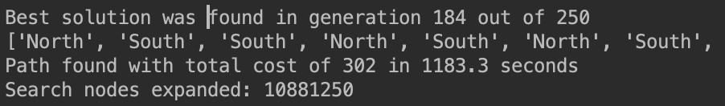
Genetic Algorithm

Slide 9
Questions?

